Slide 1


SENTENCE PARSING PROGRAM (WITH MIND MAP) A Program for Visualizing Sentence Structure
By Doosan Pagooah | 21st October 2024
Notes:
Hello

Slide 2

OBJECTIVE
To develop an NLP-based program that parses input sentences, identifies grammatical components, and visualizes the sentence structure using advanced tools and libraries.
Tools Used: JavaScript (using Compromise.js), Node.js (with Stanford CoreNLP on Docker).

Slide 3

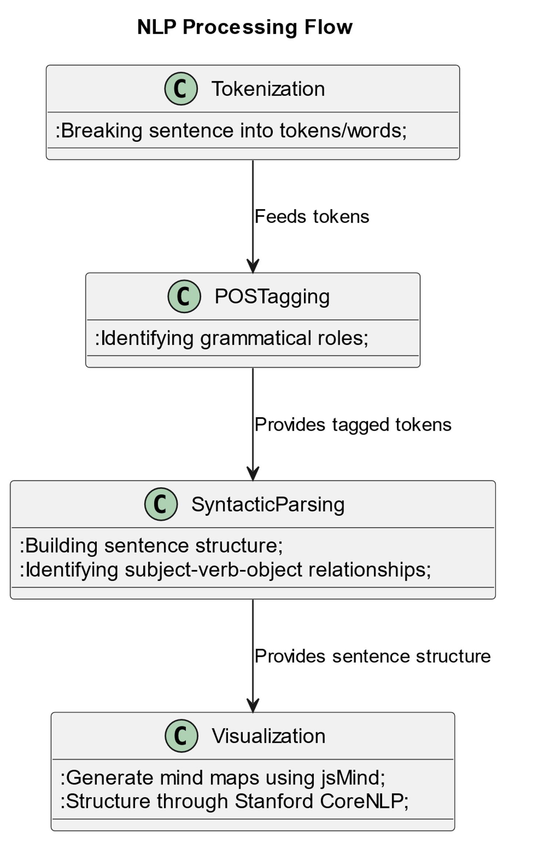
PROGRAM STRUCTURE
Tokenization (breaking the sentence into tokens/words).
Part-of-Speech (POS) Tagging (identifying grammatical roles).
Syntactic Parsing (building a sentence structure, identifying subject-verb-object relationship
Visualization (Generate mind maps using jsMind for Compromise.js and structure through Stanford CoreNLP).

Slide 4




PROGRAMMING LANGUAGE CHOSEN
Language Used
Reason for Choice
JavaScript (Compromise.js & jsMind):
Compromise.js: A lightweight JavaScript NLP library that handles tokenization, parts-of-speech tagging, and sentence analysis on the frontend.
jsMind: A JavaScript library used for creating visual mind maps to represent the parsed sentence structure in a tree format.
Node.js (Stanford CoreNLP via Docker):
Stanford CoreNLP: A powerful Java-based NLP library running in a Docker container that provides deeper syntactic and semantic analysis of sentences.
Axios/Express: Used to handle HTTP requests and create a simple API to interact with the CoreNLP server.
JavaScript (Compromise.js & jsMind):
Familiarity with web-based interfaces.
Lightweight and easy integration into client-side applications.
Provides quick, real-time parsing and visualization on the frontend.
Node.js (Stanford CoreNLP):
Offers advanced NLP features such as Named Entity Recognition (NER) and dependency parsing.
Running CoreNLP in a Docker container makes it easy to manage and scale.
Node.js provides a robust backend solution to connect with CoreNLP and handle sentence parsing at a deeper level.

Slide 5
JAVASCRIPT(JS) LIBRARY USED
Compromise.js
jsMind
Lightweight, fast JavaScript library for Natural Language Processing (NLP).
Used for tokenizing input sentences and performing parts-of-speech tagging.
Provides sentence breakdown, making it ideal for frontend applications where speed is essential.
JavaScript library for creating mind maps.
Utilized to visualize the sentence structure in a tree format, making it easier to understand sentence components.
Offers an interactive and user-friendly way to display parsed sentence structures dynamically on the web.

Slide 6
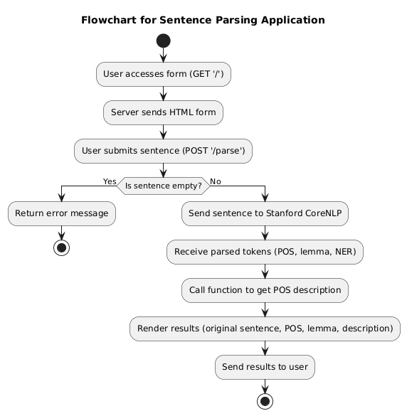
CODE IMPLEMENTATION
User inputs sentence and submits.
Server checks if sentence is empty.
If empty, returns error.
CoreNLP parses the sentence.
POS descriptions are generated.
Results are displayed to the user.

Slide 7
MIND MAP VISUALIZATION
How the sentence structure is visualized using jsMind.
How terms are processed and mapped into a hierarchical structure.
Example of how jsMind is used for visualization.
Parsed Data: Sentence is broken into tokens (words, POS tags).
Mind Map: Each token becomes a node in the mind map.
Root Node: The sentence is the root, with words branching out.
Display: jsMind displays the sentence structure visually.
Tokenize: Sentence is broken into terms (words).
Root Node: Sentence becomes the root.
Term Mapping: Each term is a child node with its POS tag.
Hierarchy: Terms branch out, forming a structured map.
Initialize Mind Map: Set the sentence as the root node.
Add Terms: Each word is added as a child node with its POS tag.
Display Structure: jsMind visualizes the sentence as a tree-like structure with words branching from the root.

Slide 8
INTERACTIVE INTERFACE
Planning
UI/UX
Design the input interface for users to enter sentences.
Ensure error handling for invalid input.
Design
Visualize parsed data in a way that makes grammatical structures easy to understand for non-experts.
Promote usability by enabling users to interact with sentence breakdowns (e.g., showing POS tags, lemmas, and NERs).
Strategy
Create real-time parsing via Node.js backend interacting with the Stanford CoreNLP server.
Build a Mind Map visualization using jsMind for displaying the sentence structure.
Use interactive elements like buttons and live sentence parsing to enhance user engagement.
Implement a step-by-step process that handles sentence tokenization, POS tagging, lemmatization, and entity recognition.
Deploy
Allow the final product to be deployed on both local and remote servers (through Docker), ensuring accessibility from multiple interfaces.

Slide 9
TESTING THE PROGRAM
TDD 1
Test individual components of the sentence parser (e.g., tokenization, POS tagging).
Ensure all components (tokenizer, POS tagger, syntactic parser, etc.) work together.
Test entire sentence parser system for functionality, performance, and stability.
Have real users test the parser to ensure it meets requirements and is user-friendly.
Final round of testing in the production environment to ensure successful deployment.
TDD 2
TDD 3
TDD 4
TDD 5

Slide 10
CHALLENGES AND ENHANCEMENTS
Compromise.js
Stanford CoreNLP
Compromise.js is faster and simpler but lacks detailed grammatical analysis.
Improvements needed for better accuracy using advanced NLP techniques.
Expand to support multi-language parsing.
Enhance visual representation of sentence structure with more flexibility.
Stanford CoreNLP offers deeper and more accurate parsing but requires complex setup and significant computational resources.
Focus on optimizing resource usage for better scalability in practical appl

Slide 11
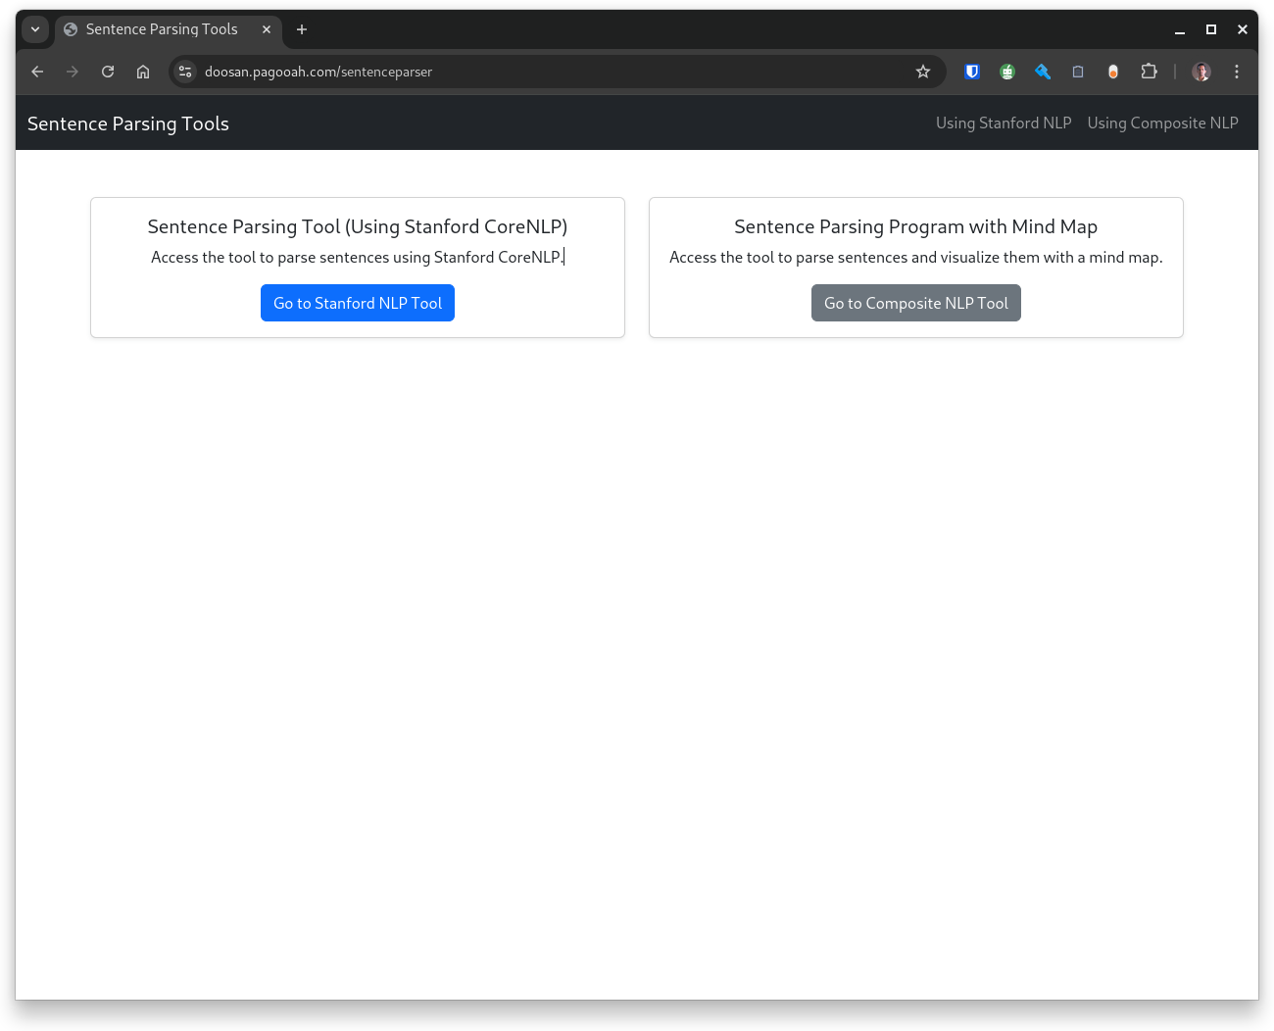
CONCLUSION
This project explores two distinct ways of implementing sentence parsing—using both lightweight JavaScript solutions and a more advanced Stanford CoreNLP server setup for comprehensive NLP analysis.

Slide 12
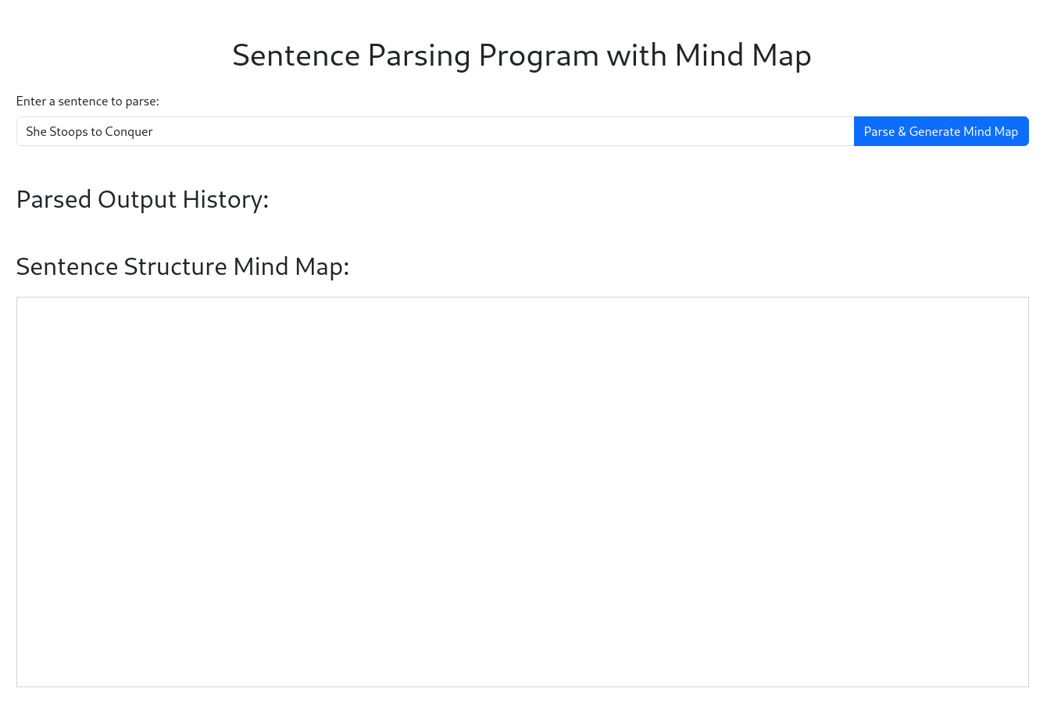
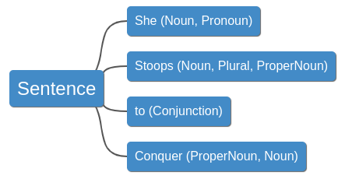
CONCLUSION
This project explores two distinct ways of implementing sentence parsing—using both lightweight JavaScript solutions and a more advanced Stanford CoreNLP server setup for comprehensive NLP analysis.

Slide 13
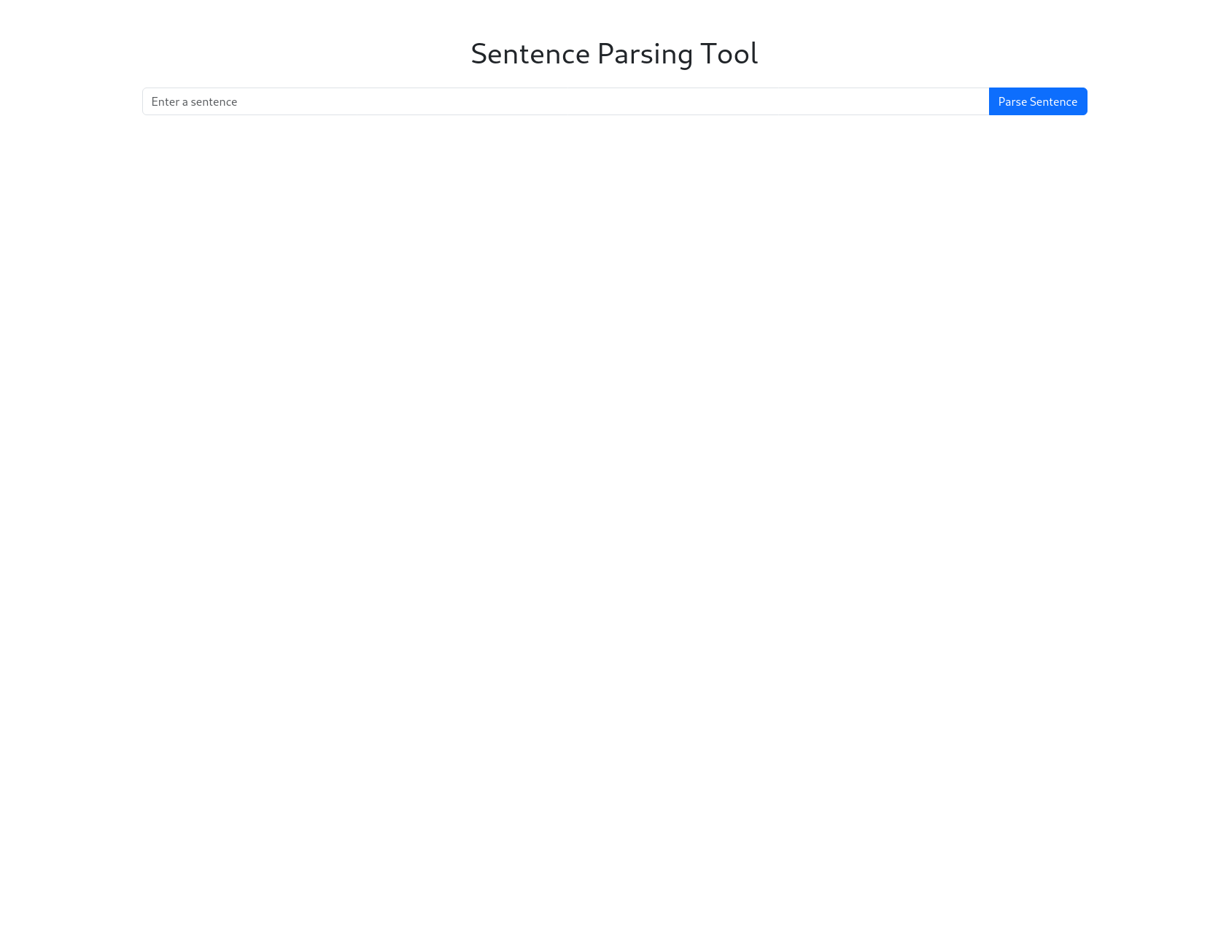
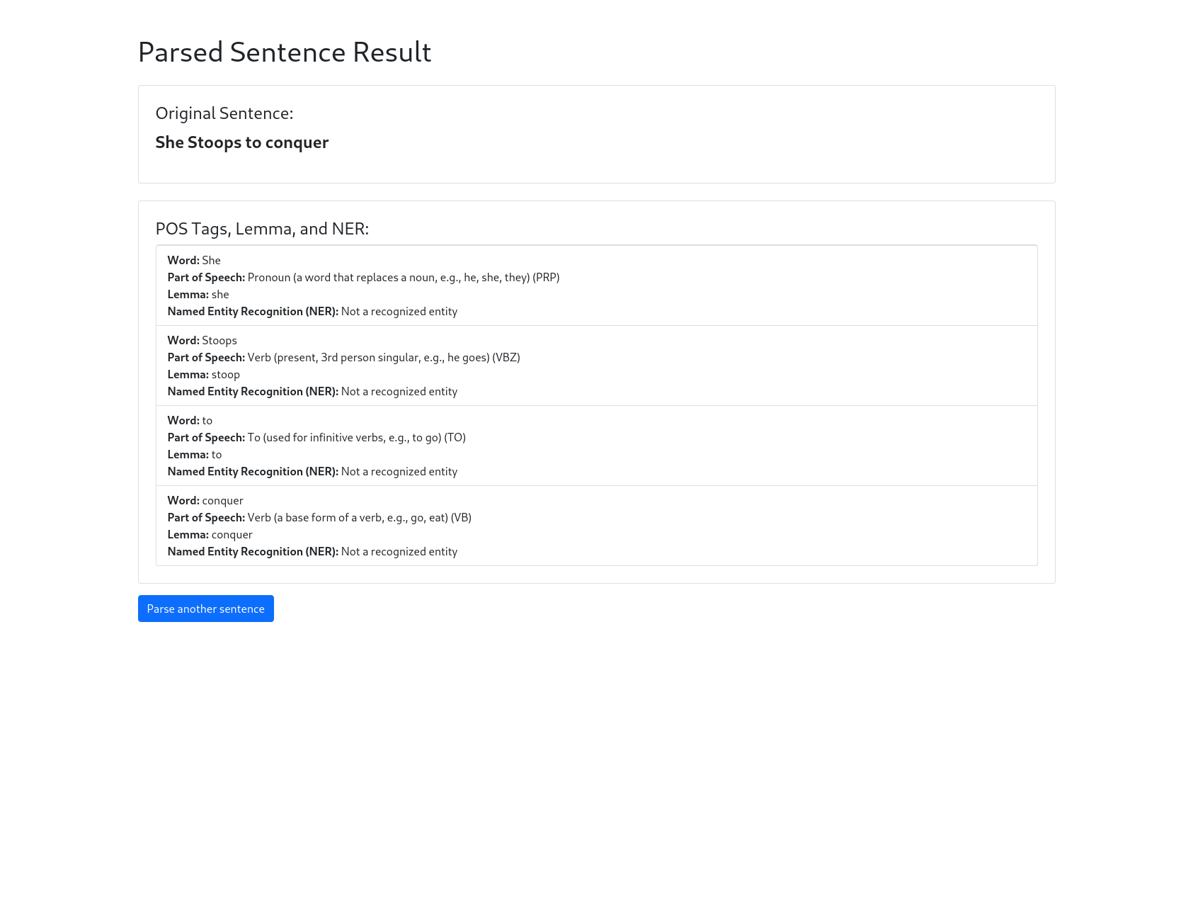
CONCLUSION
This project explores two distinct ways of implementing sentence parsing—using both lightweight JavaScript solutions and a more advanced Stanford CoreNLP server setup for comprehensive NLP analysis.

Slide 14
DEMO URL: https://doosan.pagooah.com/sentenceparser CODE REPOSITORY: https://github.com/atlascopcosaurus/SentenceParsingTools.git

Slide 15

QUESTION ?

Slide 16

THANK YOU
Doosan Pagooah
doosan.pagooah@gmail.com
www.linkedin.com/in/doosanpagooah

Slide 17
REFERENCE
Coffeewithshiva.com. (2024). Available at: https://www.coffeewithshiva.com/wp-content/uploads/2019/11/image001.png [Accessed 20 Oct. 2024].
Unsplash (2021). Photo by Kelly Sikkema on Unsplash. [online] unsplash.com. Available at: https://unsplash.com/photos/person-holding-orange-and-white-polka-dot-paper-sX_OIy4_HF8.
CoreNLP Overview CoreNLP. Available at: https://stanfordnlp.github.io/CoreNLP/ (Accessed: 23 October 2024).

